Slide 1
Is it time to invest in our public transportation system?
A look into how Nashville compares with its peers.

Slide 2
Goals
To evaluate if Nashville needs to invest more into public transportation.
Compare Nashville to some of its peers.
A view into what Nashville could look like in the future.

Slide 3
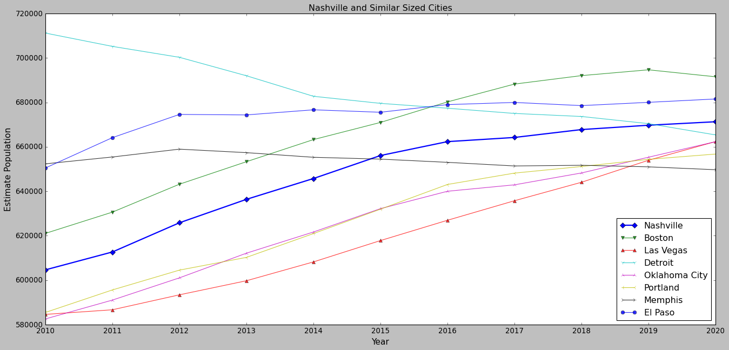
Similar Sized Cities to Nashville
Notes:
On this slide, we are taking a look at Nashville’s population growth over the last decade. I have also plotted a couple of cities that have similar populations. The range I chose was +- 5% Nashville’s population in 2020.
This range was arbitrarily chosen but it gave me a good number of neighboring cities.
One thing to note is some of the trajectories of these cities. While the majority are on an upward trend, cities such as Detroit and Memphis are going in the opposite direction.

Slide 4
Benefits of public transportation
Public transportation reduces air pollution
Increases mobility
Encourages healthier habits
Reduced traffic congestion

Slide 5
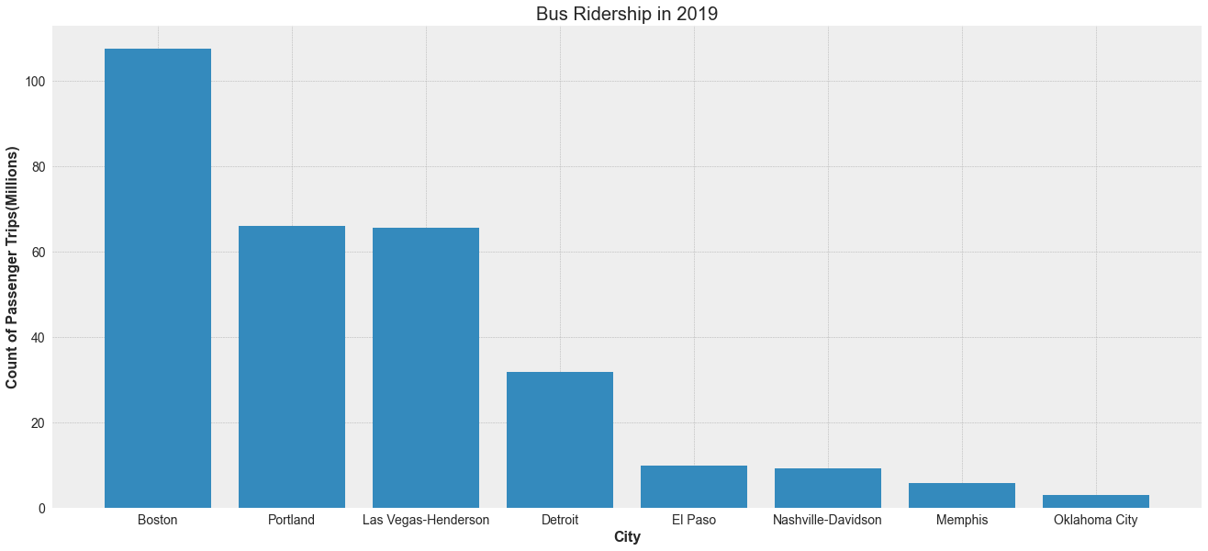
Looking at the most common mode of public transportation.

Slide 6
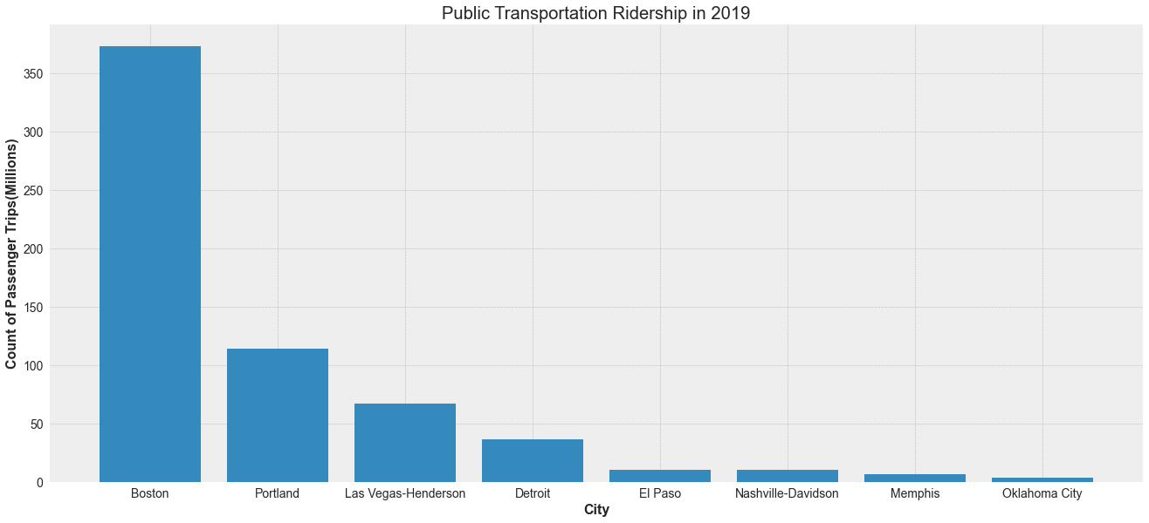
Total Ridership 2019

Slide 7
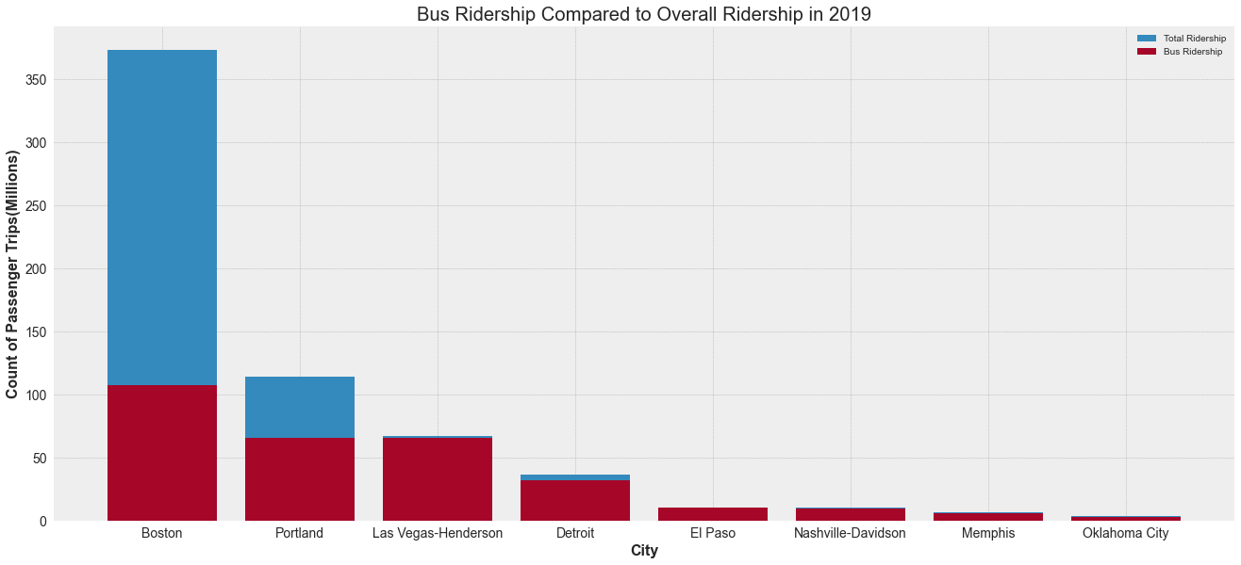
Bus Ridership vs Overall

Slide 8
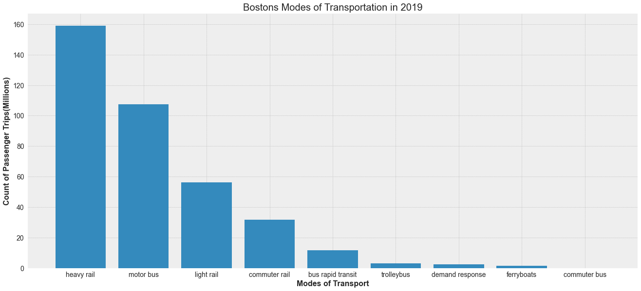
Boston’s Modes of Transportation

Slide 9
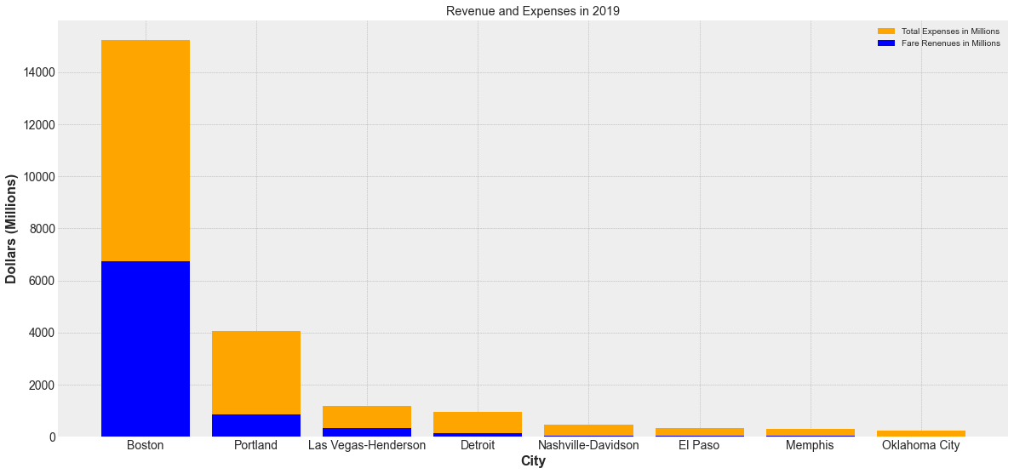
Revenue and Cost Breakdown

Slide 10
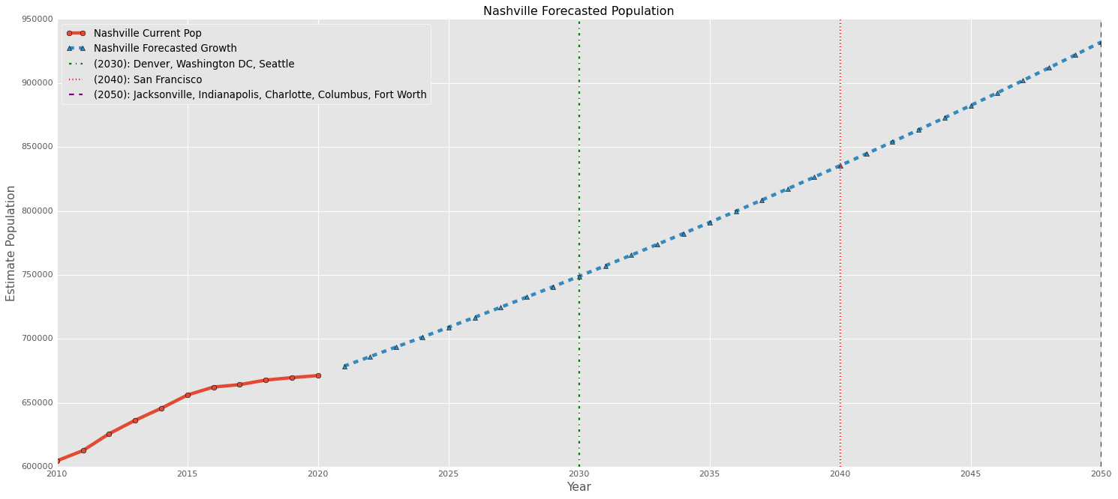

Slide 11
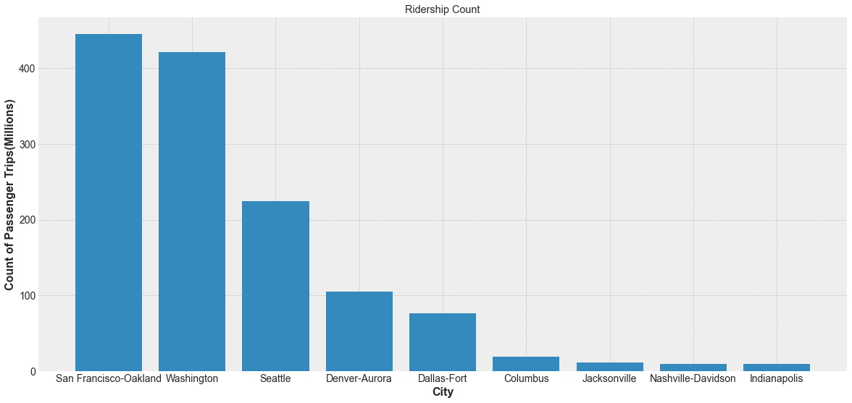
Future Ridership

Slide 12
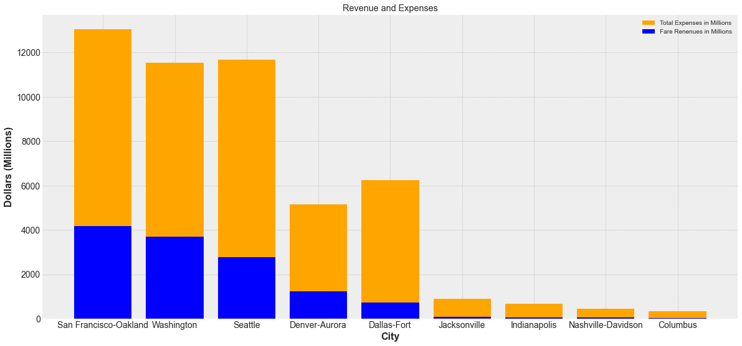
Future Revenue and Expenses

